Slide 1

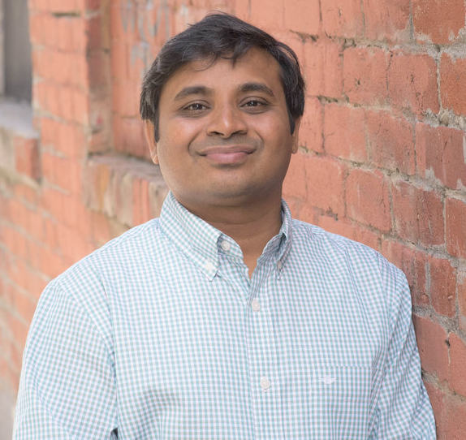
Intermediate
DevOps
KANGEYAN PASSOUBADY (KANGS)
Kavin School

Slide 2

Hello...
About me...
25+ years in IT
Principal Automation Architect currently
Co-founder of Kavin School
Enjoys coding and watching streaming videos
Kangs
(he/him)
with Pluralsight Company.
Notes:
Mandatory
ACTION: Adjust to fit you.
Script: I am [insert name] with DevelopIntelligence. We’re the training partner for [insert client name]. [Provide brief info on your background.]
Wing it!!! Keep it short!!! (Under 2 minutes; less than 1 is even better). Your goal is to establish rapport. You’re just trying to connect with the students. For example...
Here’s a little about my background in case you want this for reference later. Fun fact: [insert a piece of trivia about your personal life…”When I’m not teaching or coding, I am a skydiver”…whatever cool hobby you are engaged in]
Avoid putting your resume here. Say only a sentence or two about your professional credentials and invite them to ask questions about your background or experiences at any point during the training.

Slide 3
Prerequisites
This course assumes you
Some experience with programming or scripting.
Exposure to basic DevOps principles
Comfort working at a Linux command line
Familiarity with Visual Studio Code.
Please Note
Whether you are just beginning or looking to enhance your skills, this course is ideal for you.
If you possess advanced expertise in DevOps, this course might not be suitable for your skill level.
Feel free to reach out to me so we can connect you with the appropriate resources.
Notes:
Mandatory
ACTION: Adjust prerequisites to fit your course. Keep it brief.
Script: Before we start, I want to make sure everyone is in the correct class. Take a look at these prerequisites and message me in Chat if you have questions or aren’t sure you’re in the right spot.

Slide 4






































We teach over 400 technology topics
Notes:
Mandatory
Script: DevelopIntelligence teaches a lot of different tech. If there’s a technology you want to learn and you don’t see it in your company’s learning catalog, let your manager know. We’d be glad to help.”

Slide 5



You experience our impact on a daily basis!
Notes:
Mandatory
Script: In your everyday life, you come across tech many times a day. When you shop online. When you pay for your morning coffee. When you watch a movie or travel. We train software developers and IT professionals who work on many of the products and services you use daily.
In fact, when you talk on the phone, watch a movie, connect with friends on social media, drive a car, fly on a plane, shop online, and order a latte with your mobile app, you are experiencing the impact of our solutions.

Slide 6
We teach technology:
SECURITY
Certification prep (CompTIA)
Security literacy and fundamentals
Security architecture and engineering
Security development
Security operations
Security testing
Governance, compliance, and risk
Secure Coding
Cybersecurity
Information Security
SOFTWARE DEVELOPMENT
Frontend web development
Backend web development
Mobile development
Software testing
Software architecture
Version control
Java
Python
JavaScript
C#, C++
Ruby
Swift
Kotlin
TypeScript
PHP
Go
Over 400+
Expert led, hands-on learning experiences that can be tailored to your company, tech stack, audience & objectives.
IT OPS
22%
IT fundamentals and practices
Identity management
Configuration management
Containers
DevOps
Endpoint management
IT automation
Management and monitoring
Messaging and collaboration
Mobile device management
Network infrastructure
Operative systems and stacks
Server infrastructure
Storage
Virtualization
Container orchestration
Desktop administration
Certifications
ITIL
PRODUCT + PROJECT MANAGEMENT
Tech Leadership skills
Scrum
Stakeholder management
Business analysis
Project management
User experience design
Project estimation
Product strategy
Quality management
Project requirements
JIRA
Product Management
Agile Development
Product owner
Change management
PMP prep
Risk Management
Agile and scrum certifications
CLOUD
DATA/MACHINE LEARNING
Amazon Web Services
Microsoft Azure
Google Cloud Platform
Multi-cloud
Certifications
Cloud literacy
Cloud transformation
Cloud management and monitoring
Cloud security
Serverless workloads
Big data/ML/AI in the cloud
Cloud identity access management
Cloud cost control and optimization
DevOps in the cloud
Cloud compute and containerization
Cloud network management and configuration
Data analytics
Data engineering
Data management
Data science
Data literacy
Machine learning
AI
NLP
AI/GENERATIVE AI
Generative AI
Languages and Libraries
Chat Bots
Speech Recognition
Image Recognition
Sentence Classification
Notes:
Mandatory
Script: Pluralsight teaches a lot of different tech. If there’s a technology you want to learn and you don’t see it in your company’s learning catalog, let your manager know. We’d be glad to help.”

Slide 7
My pledge to you:
I will…
Make this course interactive
Ask you questions
Ensure everyone can speak
Create an inclusive learning environment
Use an on-screen timer for breaks
…also, if you have an accessibility need, please let me know!
Notes:
Mandatory
Script: This is my pledge to you. I’d like to talk in particular about the third bullet. Sometimes in a class, an enthusiastic participant will want to speak out in every discussion, answer every question and so forth. I want to make sure all of you have the opportunity to be heard. So, if I haven’t heard from you in awhile, I may call on you or check in via chat, because I want to make sure everyone gets their questions answered.
Also, I want to demonstrate the timer and confirm that everyone can see it. EggTimer is a good timer - https://e.ggtimer.com/

Slide 8
Student Introductions
What’s your job title?
Which location are you now?
Have you used Amazon Bedrock before?
What are your top 3 bucket list items?
Or a recent trip
Or a memorable event you’d like to share with the team
Your name?
and preferred pronouns?
Notes:
Optional, because you may already plan to do this in your own materials…
ACTION: We want to be sure you take time to have the students introduce themselves. It could happen here, or it could happen at the start of your materials.

Slide 9

IMPORTANT PLURALSIGHT POLICY
Notetaker apps like Read AI are not allowed in meetings.
Instructors must deny these apps access without exception.
These apps may capture sensitive information, risking privacy and IP violations.
For questions about class content, contact your instructor.
Thank you for following this policy.
Notes:
Mandatory
ACTION: Adjust bullets as per your course.
In this section, discuss the structure of the course—exercises, labs, etc.
Also, discuss any resources students will be using.

Slide 10

Recording is NOT allowed

Slide 11

What will our collaboration look like?
Present concepts with hands-on projects
Promote questions and keep discussions engaging
Engage actively with exercises, quizzes and games
Notes:
Mandatory
ACTION: Adjust bullets as per your course.
In this section, discuss the structure of the course—exercises, labs, etc.
Also, discuss any resources students will be using.
[Sources]
AI-edited illustration based on the existing user-provided slide image. No text or wording in artwork.
[/Sources]

Slide 12

What are the expectations for you?
Our pact
Enable everyone to raise questions?
Set aside dedicated, distraction-free time
Encourage an openness to learning and growth

Slide 13


Let’s get started!
Notes:
Mandatory

Slide 14
Questions?

Slide 15
Thank you!
Thank you!

